Slide 1
Insert and Format Slides
Microsoft Office Specialist Study Guide for PowerPoint 2016

Slide 2
Spring Into Action

Slide 3
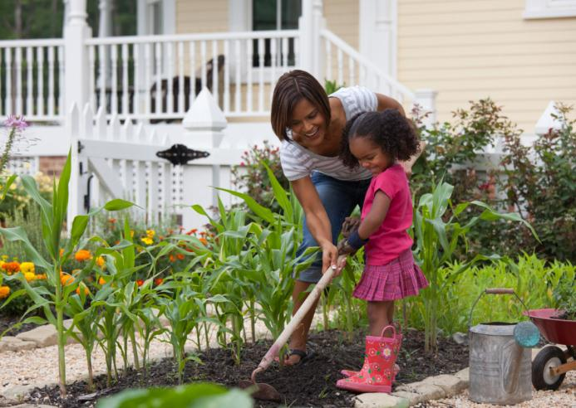
Grow your own gardener
Time together in the garden offers many opportunities for sharing information with youth

Slide 4
Summer Savings

Slide 5
Water Conservation
Plant succulents and ground cover that retain water within the soil
Decorate a portion of your landscape with rocks, colored concrete, or colored glass
During hot periods, check sprinklers weekly for damaged heads and to ensure they’re delivering water where it’s needed

Slide 6
Falling Rates

